Slide 1
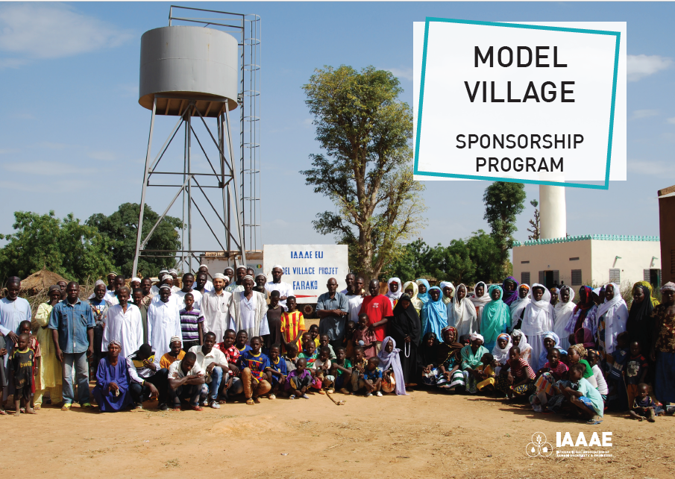

Slide 2
WHO WE ARE
The International Association of Ahmadi Architects & Engineers (IAAAE) is an international organization catering to the professional development needs of Ahmadi Muslim engineers, architects and technologists. IAAAE was founded in 1980 by Hazrat Mirza Nasir Ahmad (rh).
IAAAE is purely a professional and non-political association with the following objectives:
To promote the cause of ISLAM and the Profession of Architecture and Engineering
To interpret and correlate scientific research in the light of Holy Qur’an to substantiate the Qur’anic truth with modern discoveries
To provide assistance to the Ahmadiyya Muslim Jama’at to meet its
Architectural and Engineering needs
To promote research work, writing of research papers and exchange knowledge with similar other organizations
To provide guidance to the students of Architecture and Engineering in their career planning and other professional activities
To assist its members in the acquisition of latest techniques and knowledge and to inculcate confidence, courage and spirit to attain distinction in professional and personal conduct of life
To infuse in its members the spirit, of extreme devotion dedication, honesty, truthfulness and hard work, and to seek light and guidance of Allah in professional and personal matters

Slide 3
“
Those very people, who lived on land which was previously completely cut off from all facilities and in the middle of a jungle, are left astonished....
They never thought that their homes could have electricity or water or that their streets could ever be paved. For those people such facilities are truly unbelievable and their happiness knows no bounds.
HADHRAT MIRZA MASROOR AHMAD, KHALIFATUL MASIH V (ATBA)

Slide 4
Since 2004, under the guidance of Hadhrat Mirza Masroor Ahmad, the fifth caliph and head of the Ahmadiyya Muslim community, the Association was directed towards also providing humanitarian aid and logistical support to the poorest of the world.
Under his guidance the following Sub-committees were formed to carry out his aspirations:
Model Village
Alternate Energy
Each committee is tasked with fulfilling the following objectives:
Provide clean potable drinking water to remote parts of Africa.
Investigate and provide renewable energy solutions to remote parts of Africa.
Provide for the provision of MTA in Ahmadi villages across Africa
Aid in the design and construction of schools, hospitals, community centres and mosques to serve all.
Water For Life
Architects

Slide 5
18
MODEL VILLAGE
Model Villages completed
2
under construction
9
countries
12,000
people impacted

Slide 6
MODEL VILLAGE: IMPACT SO FAR..
MALI (3500) GHANA (350) THE GAMBIA (450)
SIERRA LEONE (800)
BENIN (950)
1
MODEL VILLAGE
100 PEOPLE IMPACTED
IVORY COAST (1000)
NIGER (1265)
BURKINA FASO (1830)
TANZANIA (3000)

Slide 7
WHAT IS IN A MODEL VILLAGE?
COMMUNITY CENTER
Used to provide training and community classes as well as enterprise (training some of the villagers to uses sewing machines, which they have then used to develop their own business)
SOCIAL ENTERPRISE
It is important to empower people to take care of themselves. Social enterprise projects in the villages will give them the platform to start a new business venture and develop financial security for the village. Projects like; Farming and irrigation, Poultry farm, Fish farm etc
MTA SATELLITE SYSTEM
Many Ahmadi villagers have not seen Huzoor (atba) or even heard his voice. Bringing MTA to these villages is a priority for tarbiyyat purposes
SOLAR WATER SYSTEM
Solar centrifuge pump installed in a deep borehole so sufficient water is
stored in tanks. These tanks will feed various water points in the village.

Slide 8
WHAT IS IN A MODEL VILLAGE?
TOILETS
Sanitary solutions are a big part of improving the village. Traditionally there may not be any privacy or safe place to go. Purpose built communal toilets will promote cleanliness and ensure all waste is stored in one location
LIGHTING
Electrification to the village is provided by a number of solutions; Independent DC Solar system for each house (powers 3 lights and charges phones), Grid electric system (Central battery room is powered by solar panels and feeds electricity to each house via cables). Solar street lights are built to light a safe passage to the village and boost security at night.
ROADS
To improve vehicular/cycle access to the village and for the safety of villagers to move around the village.
LANDSCAPE
It is important for all IAAAE Model Villages to look appealing. The landscaping works will help paint the houses, plant trees, build fences where needed.

Slide 9
IMPACT: SOCIAL
Model Villages have had a huge impact on the lives of people, especially children who would have to travel miles every day just to quench their thirst In the deserts of Africa where this scheme is being carried out.
The energy facilities and irrigation potential of these projects has allowed the villagers to focus on their livelihood instead of traveling over 10 miles per day to fetch water for their families.

Slide 10
“
It is a great blessing to serve IAAAE and provide the people of Africa these basic services to help improve their lives.
Indeed, our religion teaches us to look after those who are less fortunate then ourselves. All of our volunteers sacrifice their time to help in remote parts of Africa and only to gain the pleasure of Allah. Your support, will help us to serve more people and give them the spark needed to prosper.”
KHALID AHMAD (CHAIRMAN, MODEL VILLAGE)

Slide 11
HOW MUCH DOES IT COST?
Water System | £15,000
Solar System | £10,000
Travel, Plant and Ancillary | £3,000
Lighting | £2,000
MTA Satellite System | £1,000
Landscaping/Painting | £1,000
MINI VILLAGE
£32,000*
Water System | £25,000
Solar System | £22,000
Community Center | £10,000
Travel, Plant and Ancillary | £4,000
Roads | £3,000
Lighting | £2,000
Social Enterprise | £2,000
MTA Satellite System | £1,000
Landscaping/Painting | £1,000
HISTORIC DONORS & PARTNERS
WAQF-E-JADID FUND HUMANITY FIRST MAJLIS
KHUDDAM-UL-AHMADIYYA UK
MAJLIS ANSARULLAH UK
MODEL VILLAGE
£70,000*
*This is a minimum cost, it refers to a typical village size of 400 population.
Bigger villages may require additional funds.

Slide 12
“The opportunity to work with the engineers from IAAAE is amazing. I
have learnt so much on these trips. This work that the engineers do in remote villages is something that can’t be put into words. It has a big impact on the villagers’ faith and the faith of others in the area.”
MIAN QAMAR AHMAD (MURABBI, BENIN)

Slide 13
How do we deliver a project?
The model village projects are delivered by Students, Professionals and Novice Volunteers, with the help of local tradesmen and contractors.
Education and training is provided to villagers to ensure they can troubleshoot basic issues.
How will we involve members of your organisation with this project?
We are aiming to not only request your majlis to collect funds for these project but also physically get involved if you so wish and attend our installation visits. We will also help with providing marketing and fundraising material for you to share in your respective countries. This will help in raising the profile of our work and collaboration.
How to get involved?
Arranging fundraiser programs
Sponsoring Villages
Sponsoring segments of a village i.e. the water system, Solar system,etc
Corporate Sponsorship Programs
Waqf e Aarzi

Slide 14
“We have tried to bring in water for remote villages of Africa. Also, we
want to bring electricity so that people can benefit from these services which Allah has provided through these avenues. The Model Village encapsulates both water sources and electrification of villages.”
AKRAM AHMADI (CHAIRMAN, IAAAE EUROPE)

Slide 15
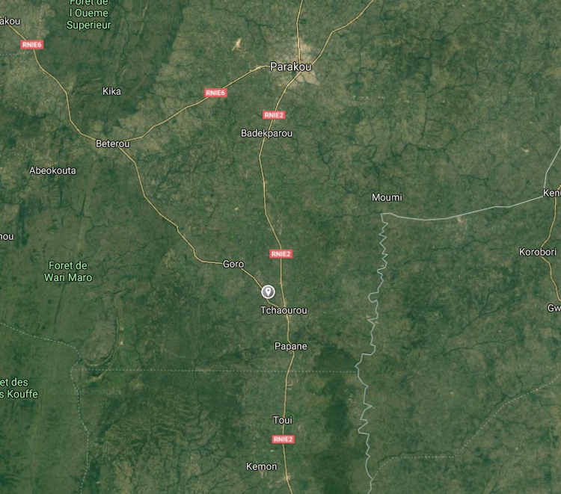
BENIN - GBEYEKAROU
Location
Central Benin- Parakou Region
Nearest Town – Tchaourou
Population
Circa 450 inhabitants
75 Houses
Ahmadi Population
Existing Amenities
Water borehole (Contaminated)
Mosque
School
Some Farming Land

Slide 16
BENIN - GBEYEKAROU
Village Scope:
Solar Water System
Water Storage System
Water Distribution System
DC Solar Electric System
Community Centre & MTA
Extension to the Mosque
Drip Irrigation System
Road Construction
Toilets and Sanitation

Slide 17
BENIN - GBEYEKAROU
BENIN - GBEYEKAROU

Slide 18
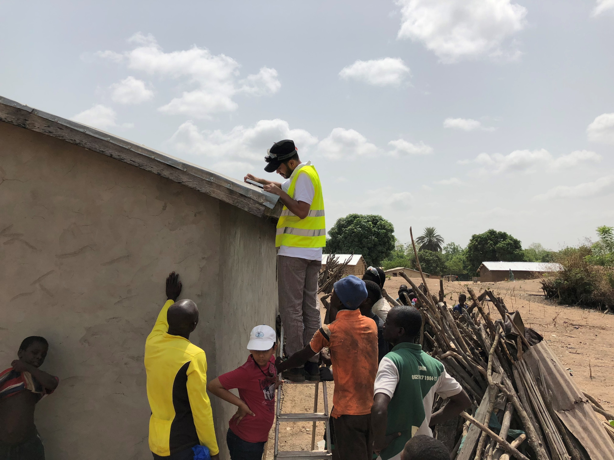
BENIN - GBEYEKAROU
BENIN - GBEYEKAROU
BENIN - GBEYEKAROU

Slide 19
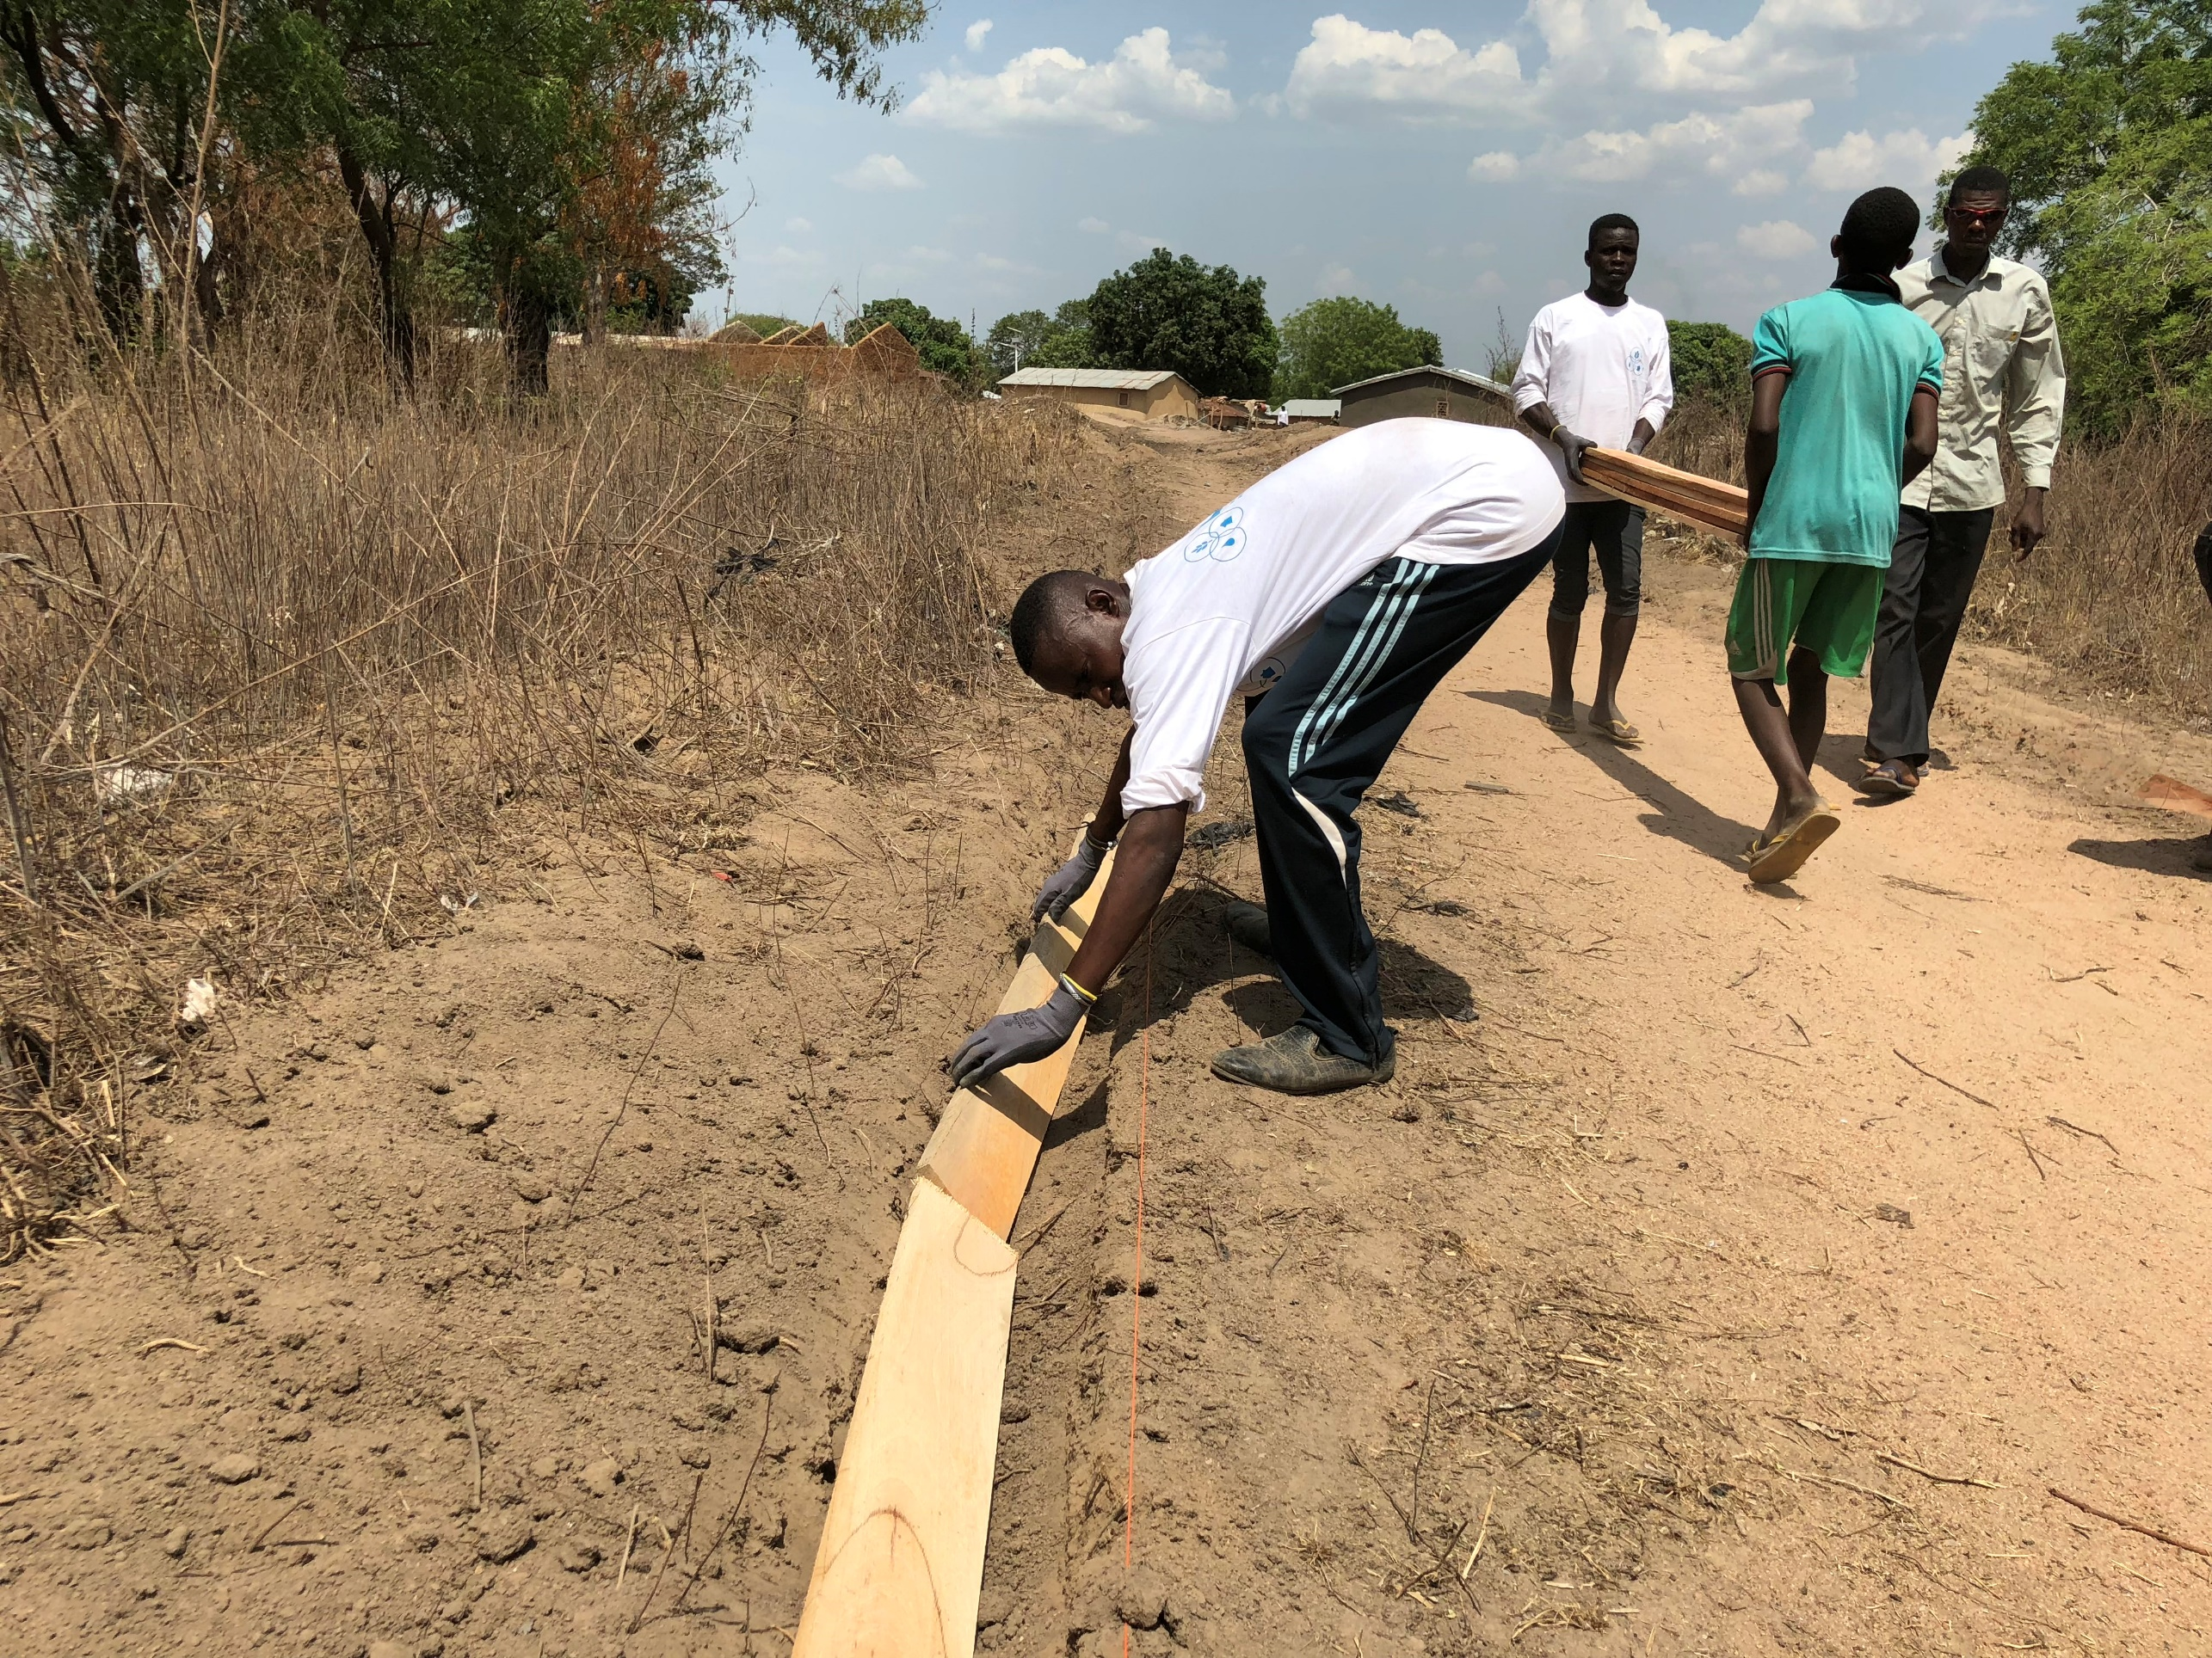
BENIN - GBEYEKAROU
BENIN - GBEYEKAROU

Slide 20
Since accepting the message of the
“
Promised Messiah (as) I have seen a massive change in my life and the life of my people. The love and caring nature of our brothers and sisters around the world is humbling. It is such a nice feeling to have people from our community help each other around the world.”
GOBI DARMAN (VILLAGE PRES, BENIN)

Slide 21
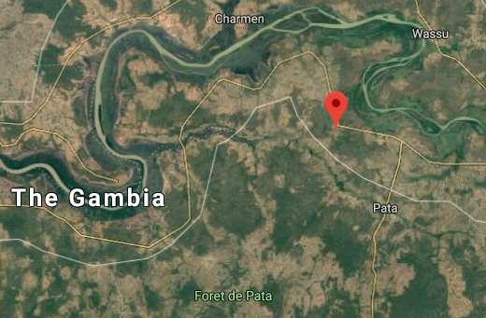
THE GAMBIA – SARE MALANG
Location
Eastern Gambia
Nearest Town –
Population
Circa 450 inhabitants
100 Houses
Ahmadi Population
Existing Amenities
Open Water Well

Slide 22
THE GAMBIA – SARE MALANG
Village Scope:
Solar Water System
Water Storage System
Water Distribution System
Centralised Electric System
Community Centre & MTA
Toilets and Sanitation

Slide 23
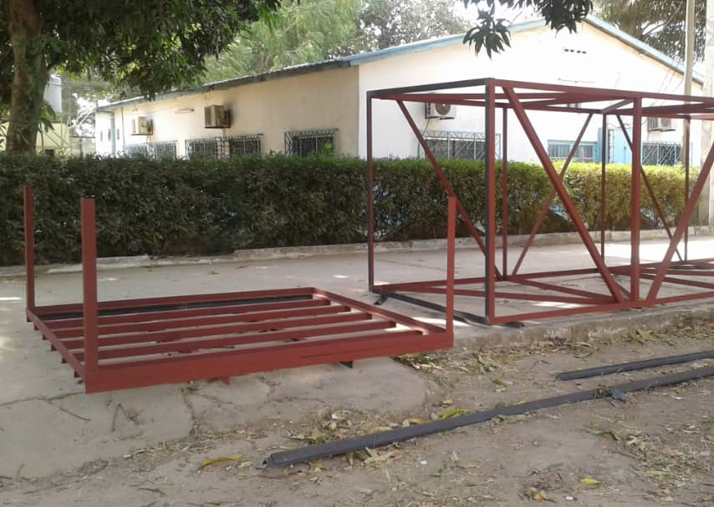
THE GAMBIA – SARE MALANG

Slide 24
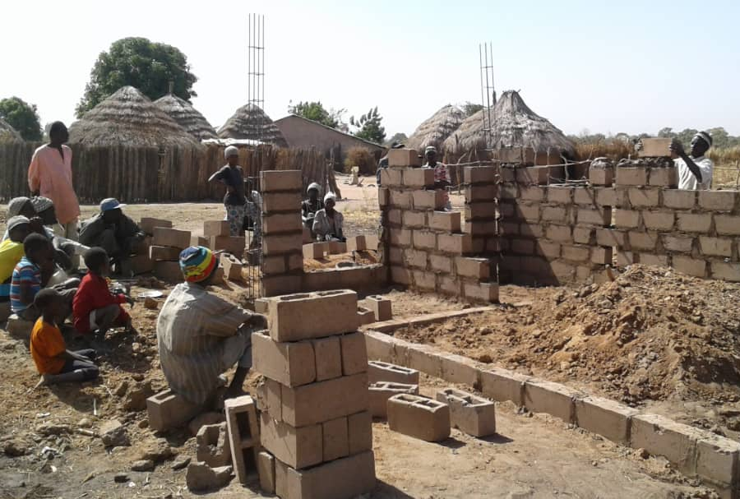
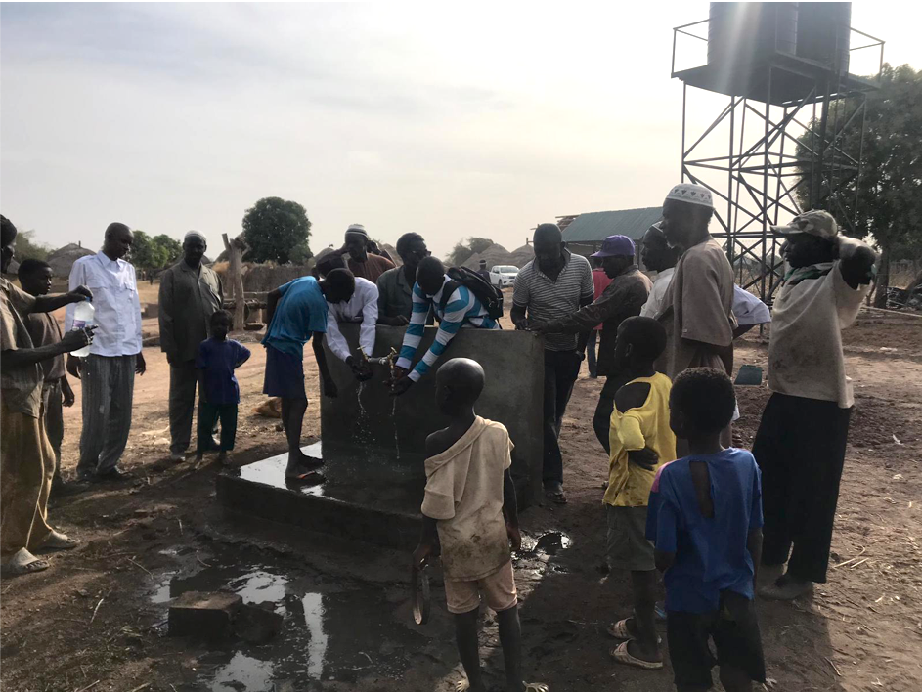
THE GAMBIA – SARE MALANG

Slide 25
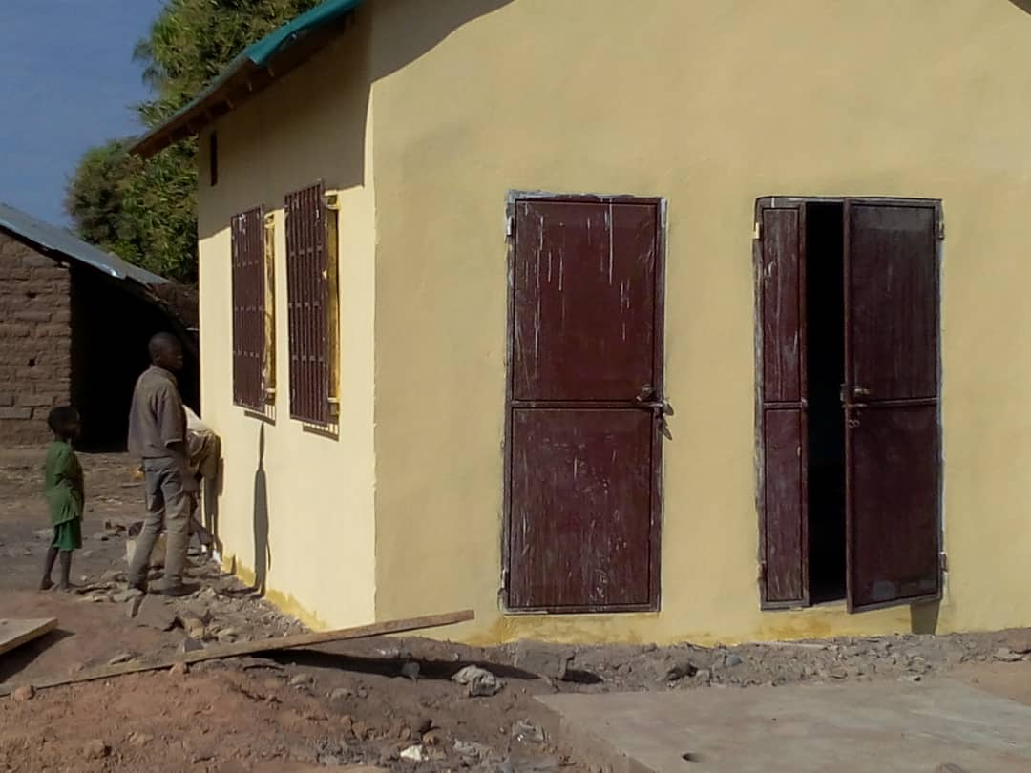
THE GAMBIA – SARE MALANG

Slide 26
EXISTING VILLAGES

Slide 27
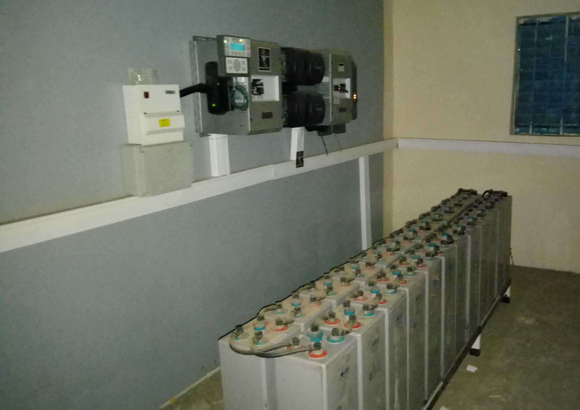
MODEL VILLAGE: NIGER

Slide 28
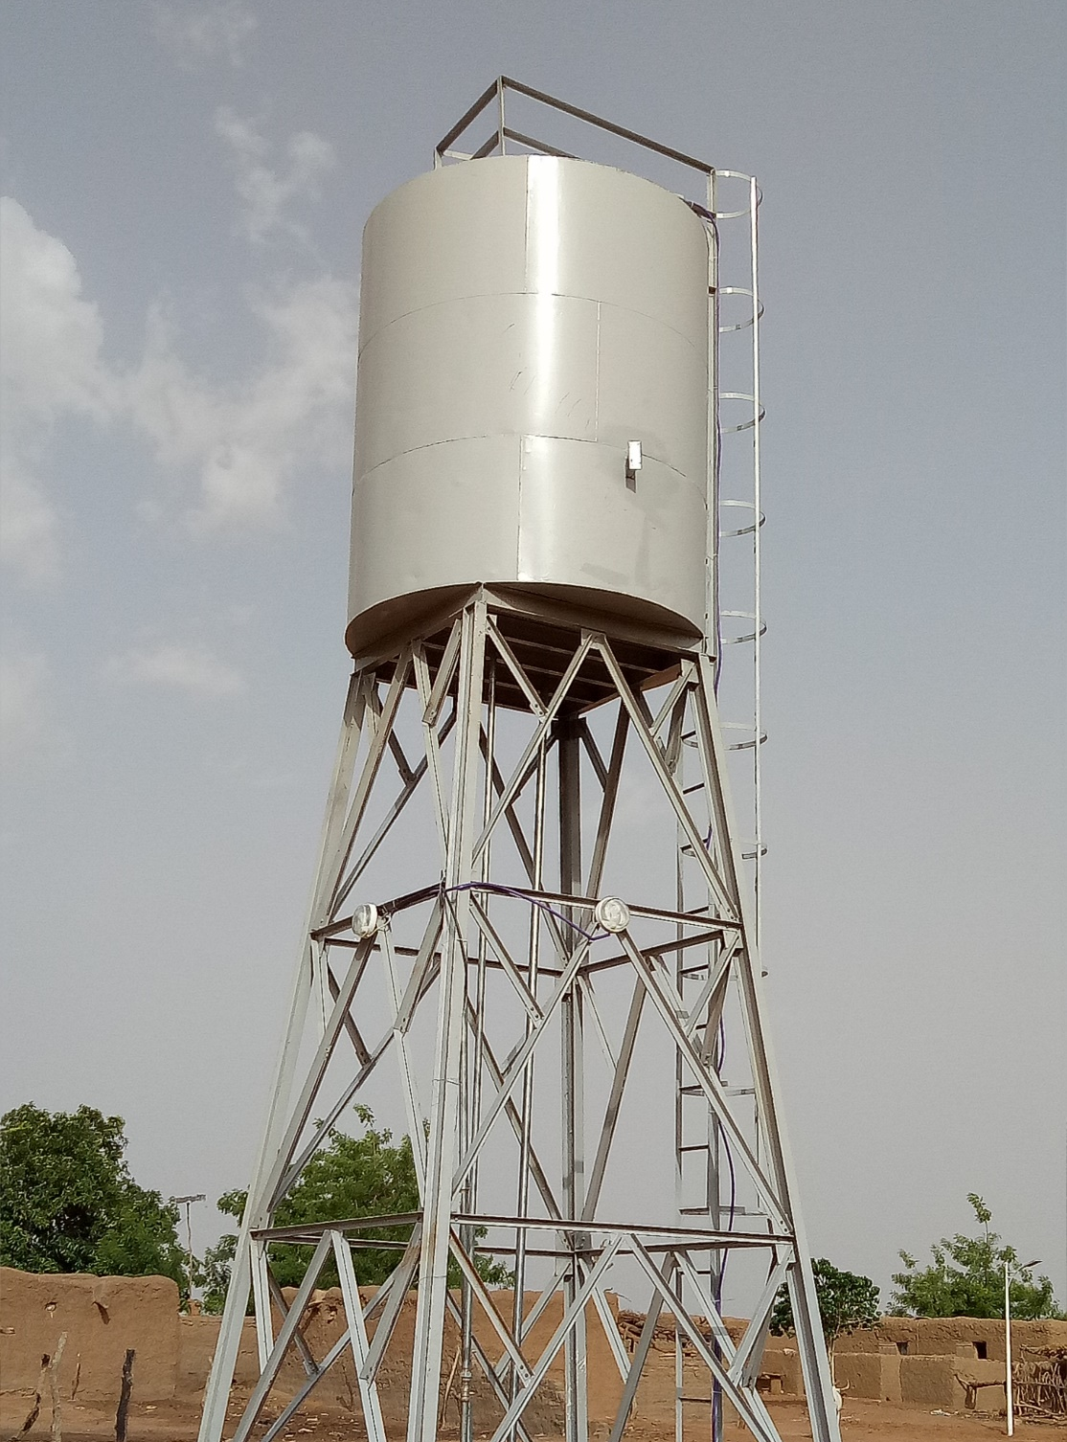
MODEL VILLAGE: NIGER

Slide 29
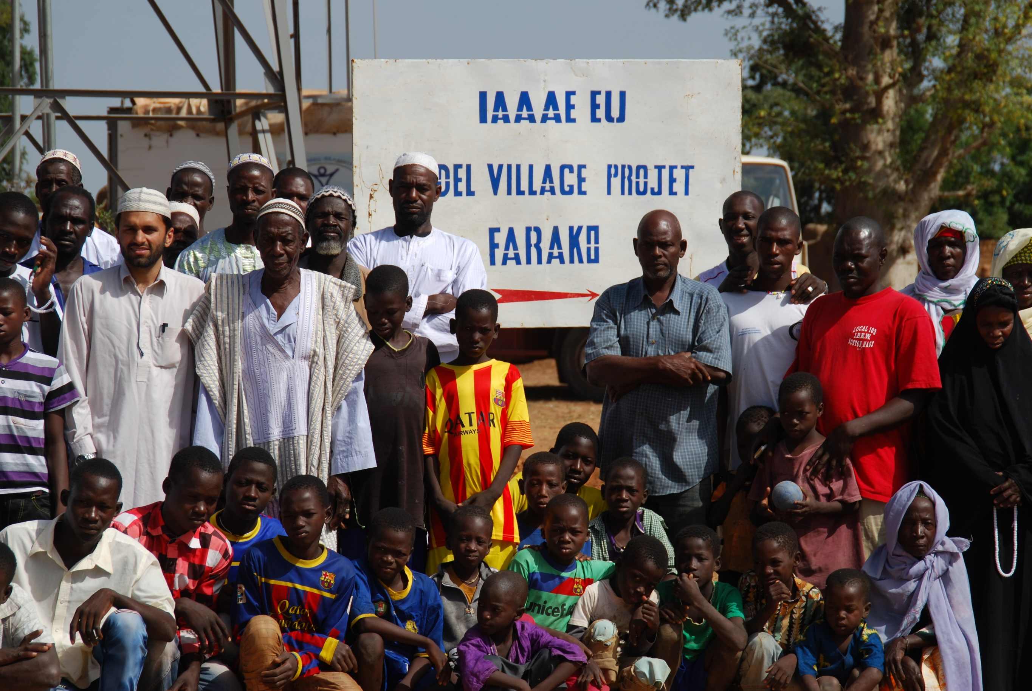
MODEL VILLAGE: MALI

Slide 30
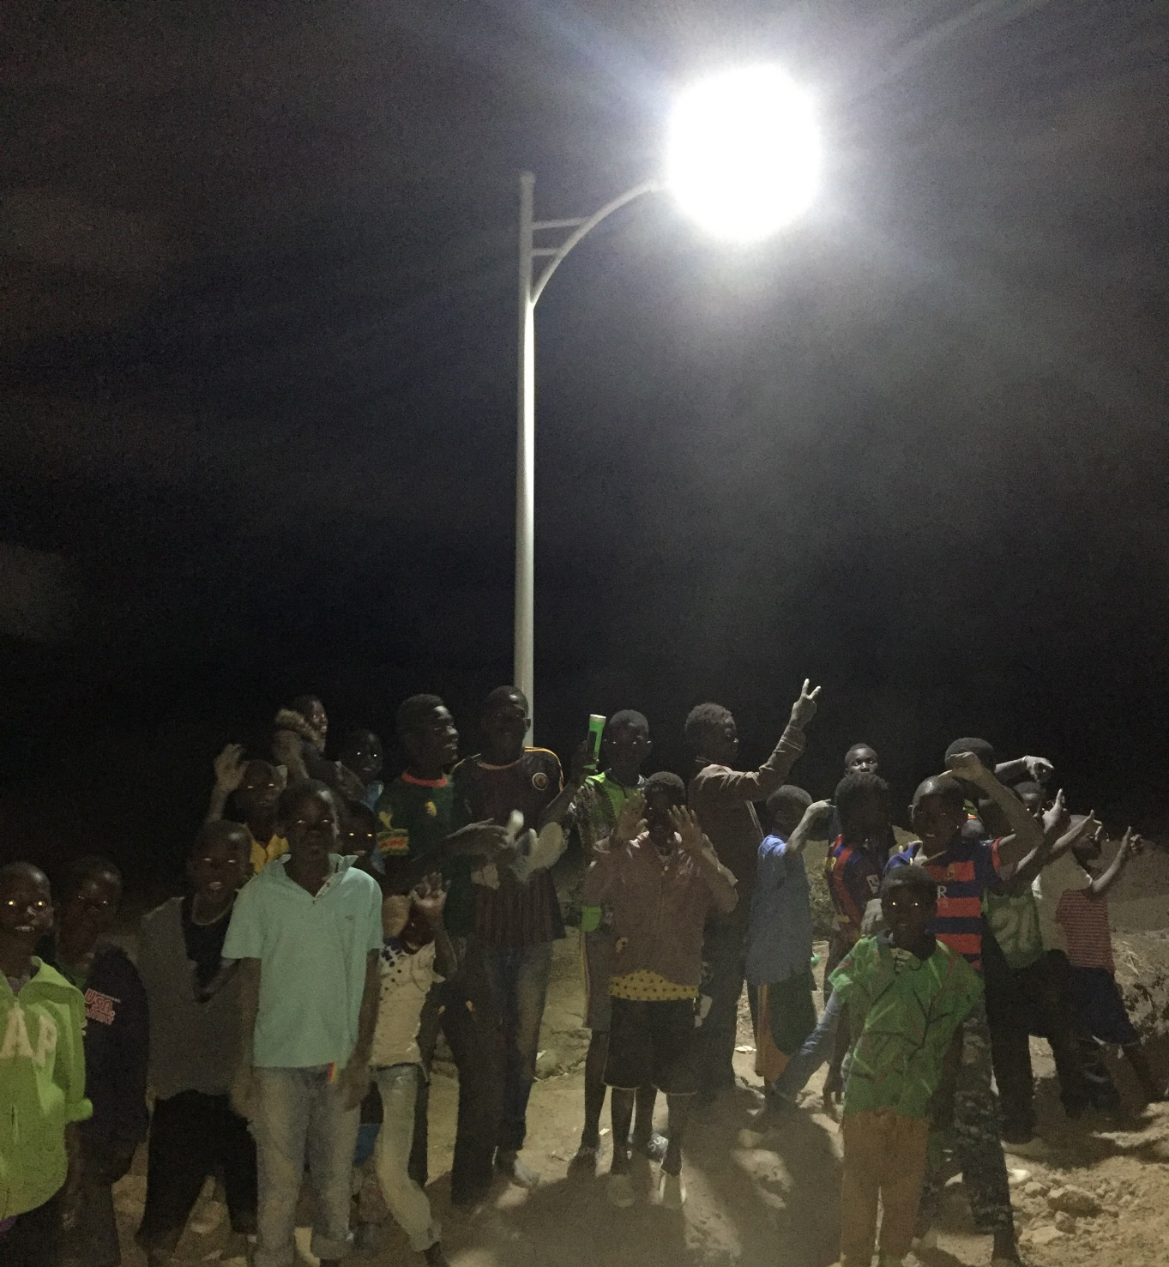
MODEL VILLAGE: MALI

Slide 31
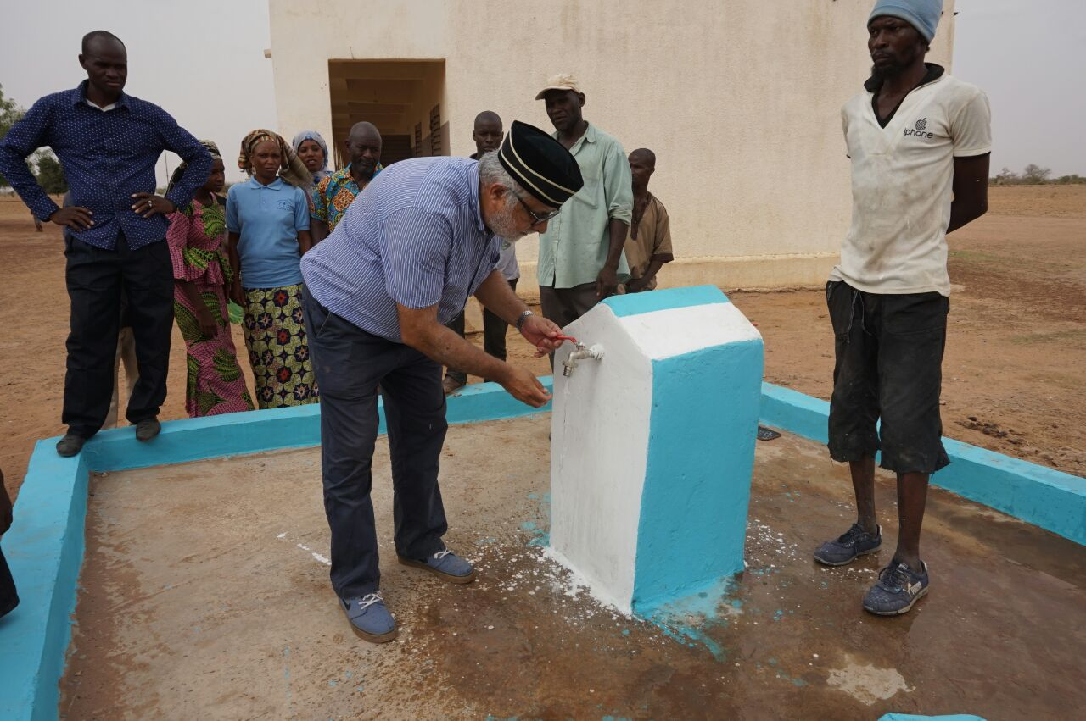
MODEL VILLAGE: MALI

Slide 32
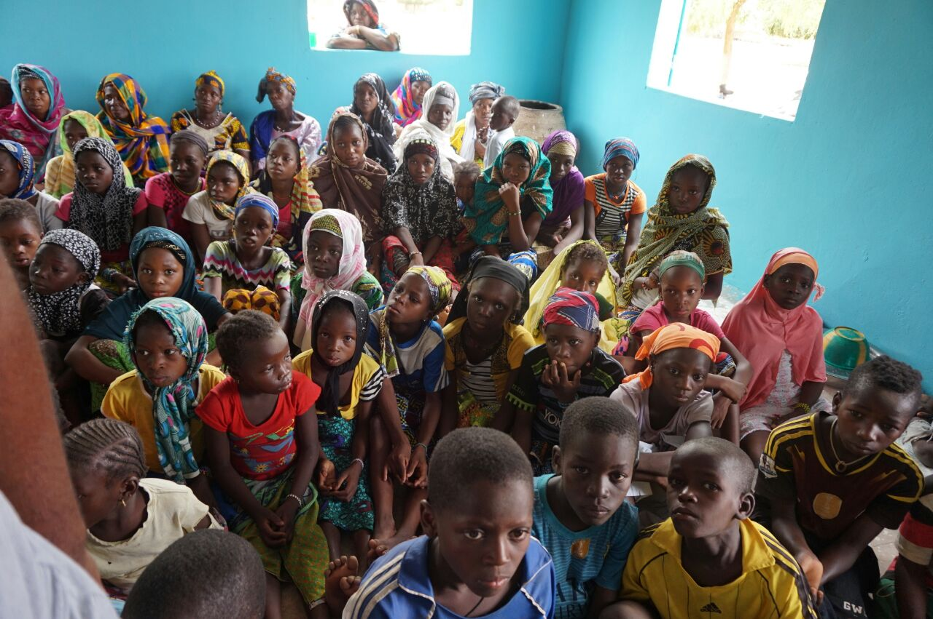
MODEL VILLAGE: MALI

Slide 33
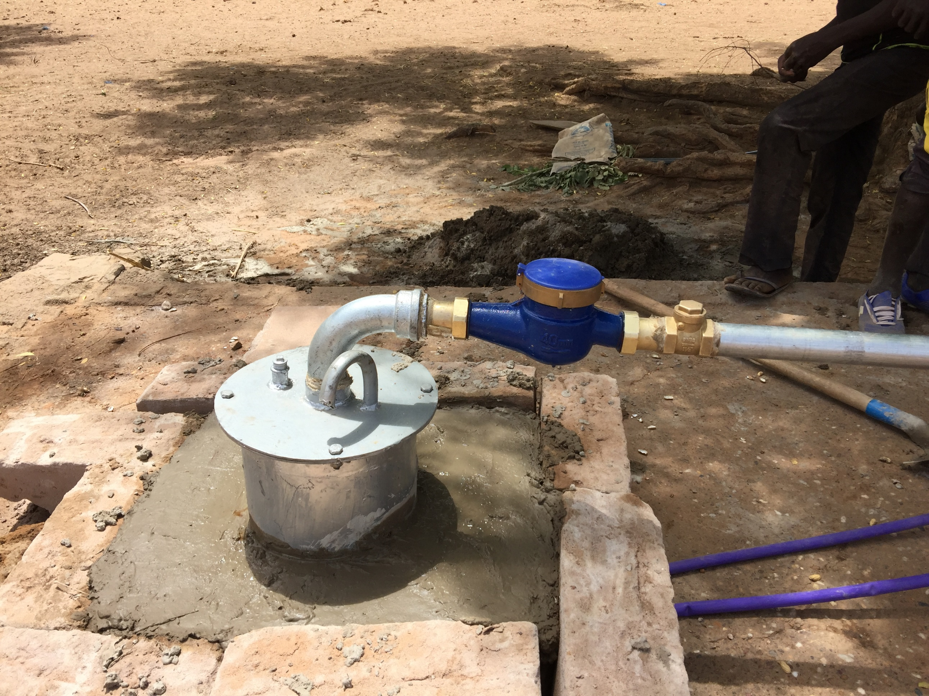
MODEL VILLAGE: MALI

Slide 34
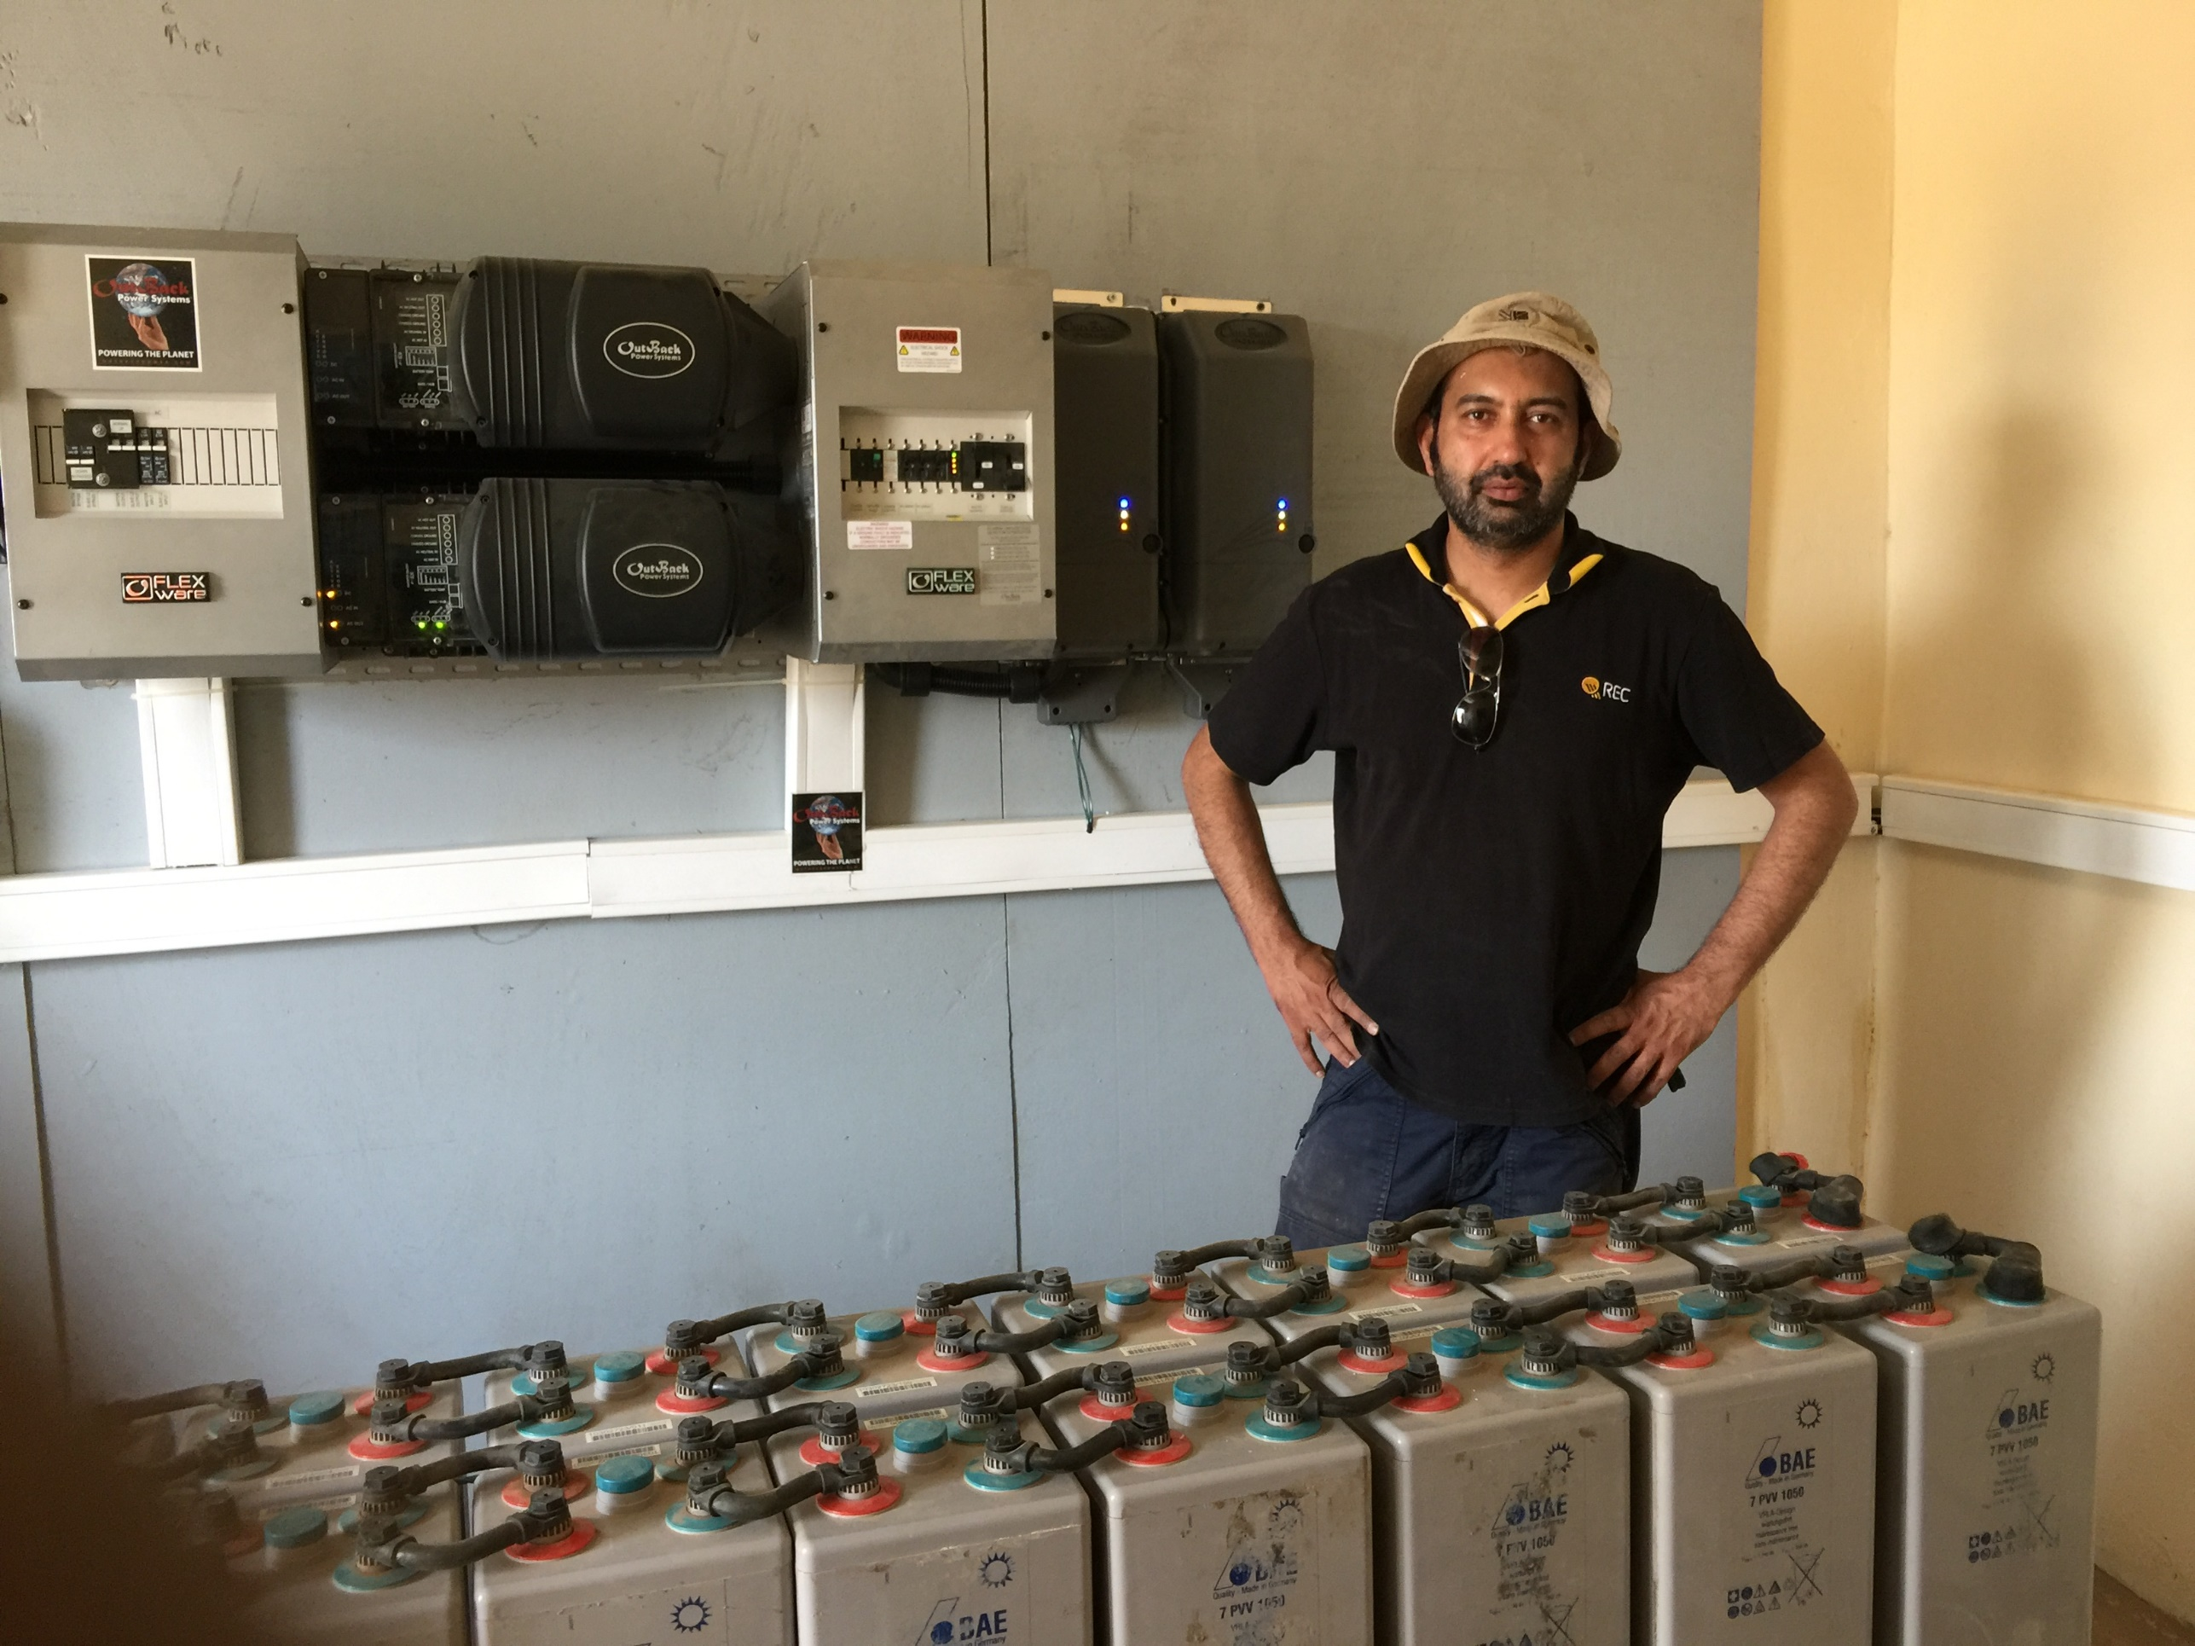
MODEL VILLAGE: MALI

Slide 35
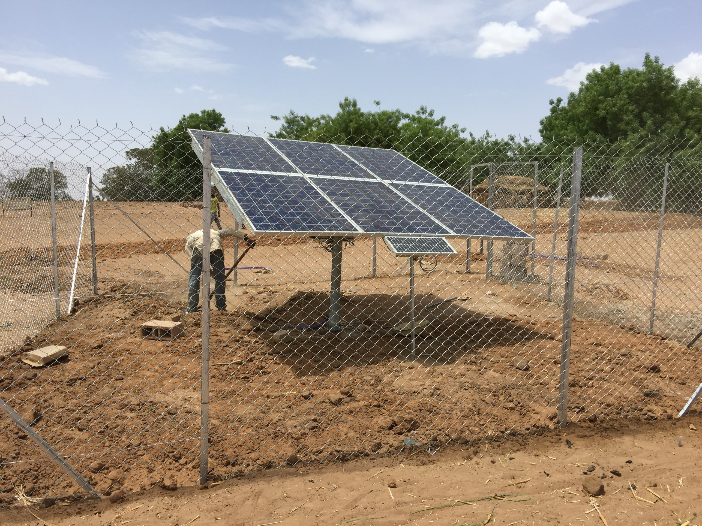
MODEL VILLAGE: MALI

Slide 36
CONTACT US
22 Deer Park Road London SW19 3UA
+44 20 8687 7812
info@iaaae.org
Chairman IAAAE Europe: Akram Ahmadi akram.ahmadi@iaaae.org
@IAAAE_org
@IAAAE_org @IAAAE.org
Chairman Model Village: Khalid Ahmad kahlidkareem@iaaae.org
Vice Chairman Model Village: Fida Ul Haque fida.haque@iaaae.org

