Slide 1
PROPHECIES & SCIENTIFIC FACTS IN THE HOLY QUR’AN

Slide 2
Qira = recitation
Qur’an = repeated/continuous recitation

Slide 3
PRAYER OF PROPHET JONAH
لَا إِلَٰهَ إِلَّا أَنْتَ سُبْحَانَكَ إِنِّي كُنْتُ مِنَ الظَّالِمِينَ
laaa ilaaha illaaa Anta Subhaanaka innee kuntu minaz zaalimeen
“There is no deity except You; exalted are You. Indeed, I have been of the wrongdoers.” Surah al-Anbiya v 88

Slide 4
PRAYER OF PROPHET MOSES
رَبِّ اِنِّیۡ لِمَاۤ اَنۡزَلۡتَ اِلَیَّ مِنۡ خَیۡرٍ فَقِیۡرٌ
‘My Lord, I am in need of whatever good You may send down to me.’
Surah al-Qassas v 25

Slide 5
PRAYER OF PROPHET ADAM
رَبَّنَا ظَلَمۡنَاۤ اَنۡفُسَنَا وَاِنۡ لَّمۡ تَغۡفِرۡ لَنَا وَتَرۡحَمۡنَا لَنَکُوۡنَنَّ مِنَ الۡخٰسِرِیۡنَ
Rabbanaa zalamnaaa anfusanaa wa-in lam taghfir lanaa wa tarhamnaa lanakoonanna minal khaasireen
“Our Lord, we have wronged ourselves, and if You do not forgive us and have mercy upon us, we will surely be among the lost.” Surah Al A’raf v 24

Slide 6
PROPHECY IN SURAH RUM
غُلِبَتِ الرُّوۡمُ ۙ﴿۳﴾
The Romans have been defeated
فِیۡۤ اَدۡنَی الۡاَرۡضِ وَہُمۡ مِّنۡۢ بَعۡدِ غَلَبِہِمۡ سَیَغۡلِبُوۡنَ ۙ﴿۴﴾
In the land nearby, and they, after their defeat, will be victorious.
فِیۡ بِضۡعِ سِنِیۡنَ
In a few (3-9) years
لِلّٰہِ الۡاَمۡرُ مِنۡ قَبۡلُ وَمِنۡۢ بَعۡدُ
Allah’s is the command before and after that
وَیَوۡمَئِذٍ یَّفۡرَحُ الۡمُؤۡمِنُوۡنَ ۙ﴿۵﴾
and on that day the believers will rejoice,

Slide 7
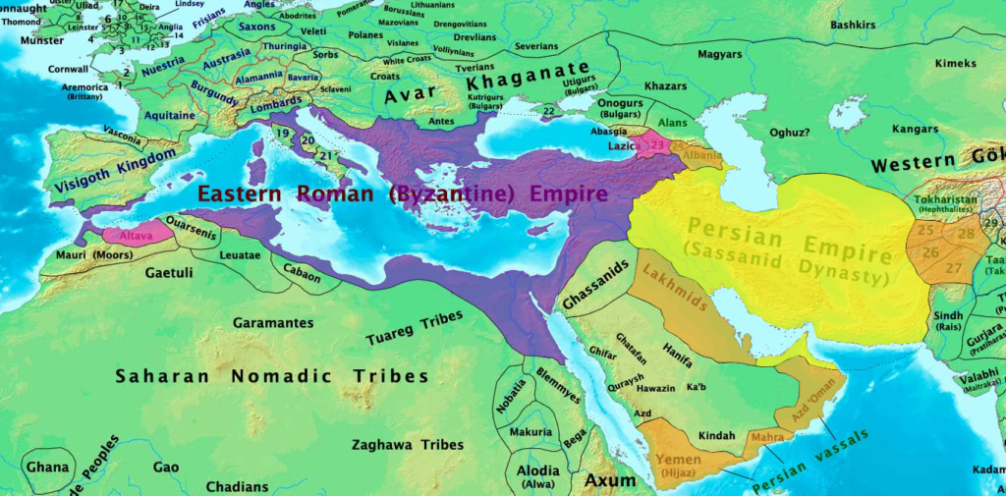
ROMAN & PERSIAN EMPIRES 615 C.E.

Slide 8
OLD FORMS OF TRANSPORT ABANDONED
واِذَا الۡعِشَارُ عُطِّلَتۡ
And when the ten month pregnant she-camels will be abandoned
Sura Al Takwir (81) verse 5

Slide 9
ZOOS & CONSERVATION AREAS
وَاِذَا الۡوُحُوۡشُ حُشِرَتۡ
And when the wild animals will be gathered together.
Sura Al Takwir (81) verse 6

Slide 10
JOINING OF THE TWO SEAS (1)
وَاِذَا الۡبِحَارُ سُجِّرَتۡ ۪
‘And when the seas are made to flow forth one into the other.’
Sura Al Takwir (81) verse 7
وَہُوَ الَّذِیۡ مَرَجَ الۡبَحۡرَیۡنِ ہٰذَا عَذۡبٌ فُرَاتٌ وَّہٰذَا مِلۡحٌ اُجَاجٌ
وَجَعَلَ بَیۡنَہُمَا بَرۡزَخًا وَّحِجۡرًا مَّحۡجُوۡرًا
‘And He it is Who shall merge the two seas together. This palatable and sweet, that saltish and bitter.. And between them He has (presently) paced a barrier and a massive partition.’
Sura Al Furq’an (25) verse 54

Slide 11
JOINING OF THE TWO SEAS (2)
مَرَجَ الۡبَحۡرَیۡنِ یَلۡتَقِیٰنِ ۙ
‘He made the two bodies of water flow. They will one day meet.
بَیۡنَہُمَا بَرۡزَخٌ لَّا یَبۡغِیٰنِ ۚ
Between them is now a barrier; they encroach not one upon the other.
Sura Al Rahman (55) verses 20-21

Slide 12
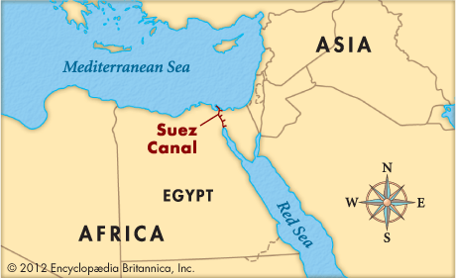
The Suez Canal (1859-1869)

Slide 13
Panama Canal (1903-14)

Slide 14
PEOPLE BEING BROUGHT TOGETHER
وَاِذَا النُّفُوۡسُ زُوِّجَتۡ ۪
‘And when people are brought together.’
Sura Takwir (81) verse.8

Slide 15
Sophisticated Forms of Communication

Slide 16
People Being Gathered Together

Slide 17
EXTENSIVE DISTRIBUTION OF BOOKS
وَاِذَا الصُّحُفُ نُشِرَتۡ ۪
‘And when the books will be extensively published and spread.’
Sura Al Takwir (81) verse 11

Slide 18
SCIENTIFIC FACTS IN THE HOLY QUR’AN

Slide 19
BIG BANG MENTIONED IN THE QUR’AN
اَوَلَمۡ یَرَ الَّذِیۡنَ کَفَرُوۡۤا اَنَّ السَّمٰوٰتِ وَالۡاَرۡضَ کَانَتَا رَتۡقًا فَفَتَقۡنٰہُمَا
Do not the disbelievers see that the heavens and the earth were a closed-up mass (ratqan), then We opened them out?
(Al- Anbiya (21) verse31)

Slide 20
IMPORTANCE OF WATER
وَجَعَلۡنَا مِنَ الۡمَآءِ کُلَّ شَیۡءٍ حَیٍّ ؕ
And We made from water every living thing
(Al- Anbiya (21) verse31)
.

Slide 21
FUTURE OF THE UNIVERSE
یَوۡمَ نَطۡوِی السَّمَآءَ کَطَیِّ السِّجِلِّ لِلۡکُتُبِ ؕ کَمَا بَدَاۡنَاۤ اَوَّلَ خَلۡقٍ نُّعِیۡدُہٗ ؕ وَعۡدًا عَلَیۡنَا ؕ اِنَّا کُنَّا فٰعِلِیۡنَ
Remember the day when We shall roll up the heavens like the rolling up of written scrolls by a scribe. As We began the first creation, so shall We repeat it — a promise binding upon Us; We shall certainly perform it.
Al Anbiya (21) verse105

Slide 22
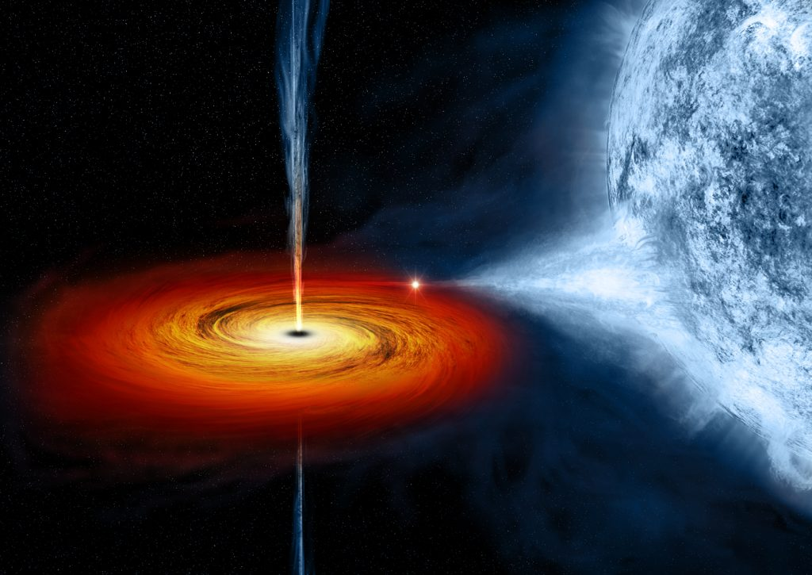
Artist Impression Of the Future of the Universe
Note the scroll-like ripples emanating from its sides.

Slide 23
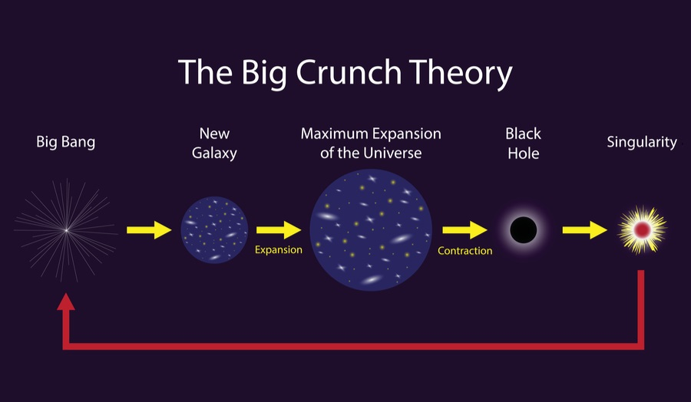
Cycle of Creation

Slide 24
EMBRYOLOGY (1)
وَلَقَدۡ خَلَقۡنَا الۡاِنۡسَانَ مِنۡ سُلٰلَۃٍ مِّنۡ طِیۡنٍ ﴿ۚ۱۳﴾
Verily, We created man from an extract of clay;
ثُمَّ جَعَلۡنٰہُ نُطۡفَۃً فِیۡ قَرَارٍ مَّکِیۡنٍ ﴿۪۱۴﴾
Then We placed him as a drop of sperm in a safe depository.
ثُمَّ خَلَقۡنَا النُّطۡفَۃَ عَلَقَۃً فَخَلَقۡنَا الۡعَلَقَۃَ مُضۡغَۃً
Then we fashioned the sperm into a clot; then We fashioned the clot into a shapeless lump;
Surah Al-Muminun (23) 13-14

Slide 25
EMBRYOLOGY (2)
فَخَلَقۡنَا الۡمُضۡغَۃَ عِظٰمًا فَکَسَوۡنَا الۡعِظٰمَ لَحۡمًا
then We fashioned bones out of this shapeless lump; then We clothed the bones with flesh;
ثُمَّ اَنۡشَاۡنٰہُ خَلۡقًا اٰخَرَ
then We developed it into another creation
فَتَبٰرَکَ اللّٰہُ اَحۡسَنُ الۡخٰلِقِیۡنَ ﴿ؕ۱۵﴾
So blessed be Allah, the Best of creators.
Surah Al-Muminun (23) 14-15

Slide 26
VERDICT OF A SENIOR DOCTOR
“More than a thousand years before our time, at a period when whimsical doctrines still prevailed, men had… the Qur’an. The statements it contains express in simple terms truths of primordial importance which man has taken centuries to discover.”
The Bible, the Qur’an and Science, pg. 220

Slide 27
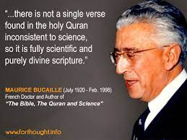

Slide 28
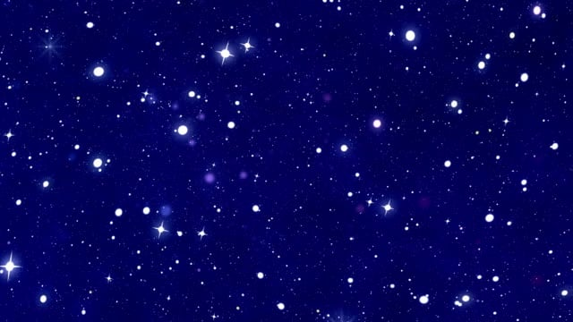
Is There Extra terrestrial Life?
There are 200 billion trillion stars in the sky - more than the grains of sand in this earth –
an estimated 10 billion trillion trillion (10,000,000,000,000,000,000,000,000) planets

Slide 29
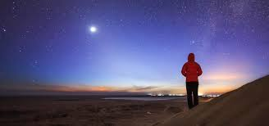
Are We Alone?
An estimated 100 quintillion planets – I00,000,000,000,000,000,000 -contain water

Slide 30
Qur’an’s Answers (1)
وَمِنْ آيَاتِهِ خَلْقُ السَّمَاوَاتِ وَالْأَرْضِ وَمَا بَثَّ فِيهِمَا مِن دَابَّةٍ ۚ
“And among His Signs is the creation of the heavens and the earth, and of whatever living creatures (dābbah) He has spread forth in both.
Al-Shuara (42) verse 30

Slide 31
Qur’an’s Answers (2)
وَهُوَ عَلَىٰ جَمْعِهِمْ إِذَا يَشَاءُ قَدِيرٌ
And He has the power to gather them together (jam-‘i-him) when He will so please.”
Al-Shuara (42) verse 30

Slide 32
PROPHECIES & SCIENTIFIC FACTS IN THE HOLY QUR’AN

