Slide 2
Talimulquran.Ahmadiyya.uk

Slide 3
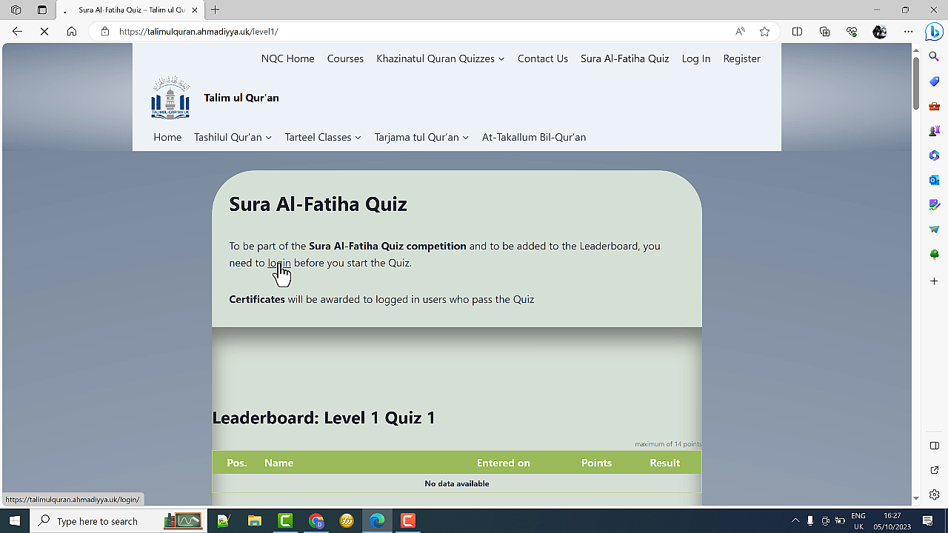
Sura Al-Fatiha Quiz Page

Slide 5
Your Score

Slide 6
Review of Questions

Slide 7
Print Certificate

Slide 8
The Certificate

Slide 9
Leaderboard

